Slide 1
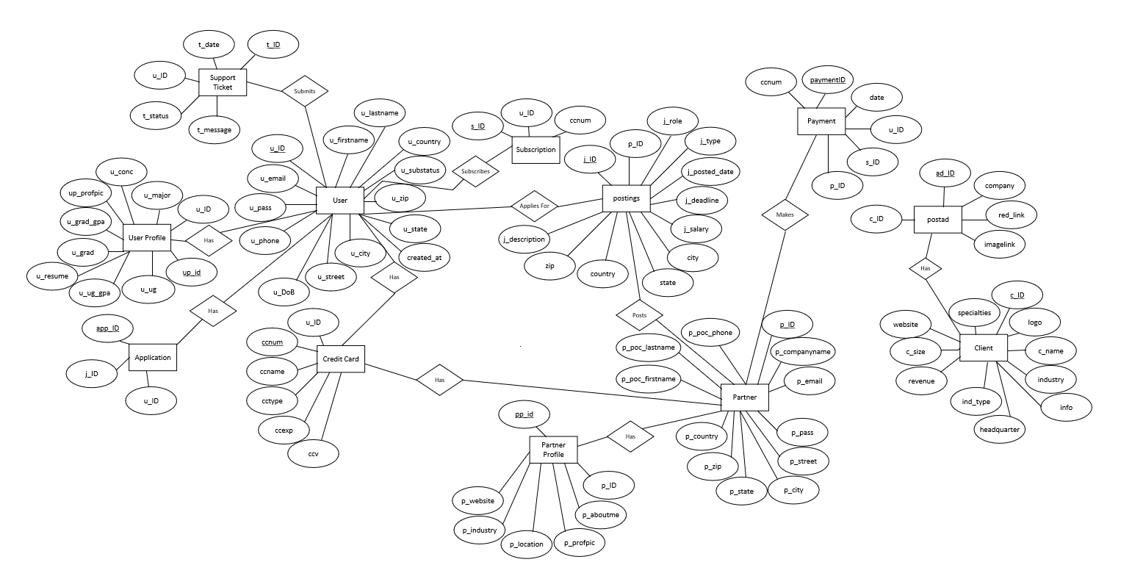
Conceptual ER Diagram – R1
Team 1
Jobster

Slide 2
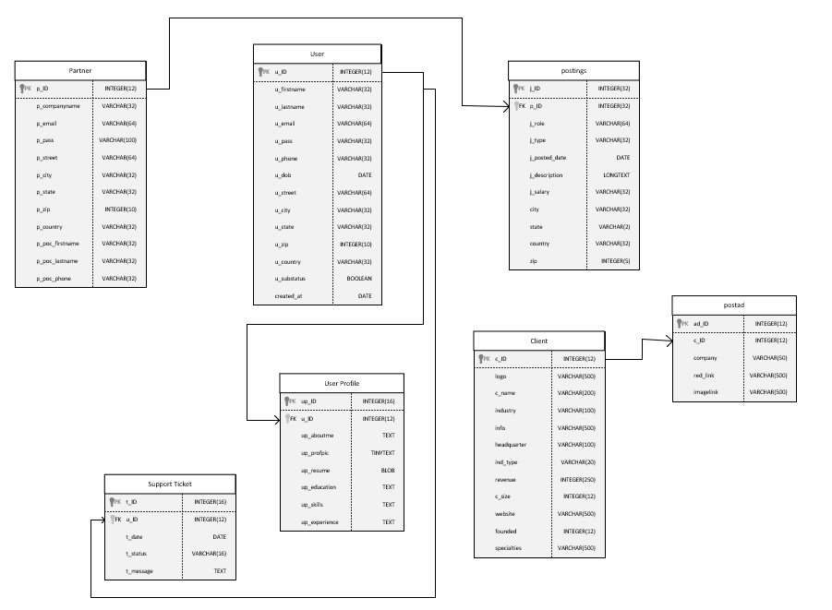
Logical ER Diagram R1
Team 1
Jobster

Slide 3
REVISION NOTES:
A few corrections to logical diagram data types for consistency with database.
created_at attribute added to User table
Job table converted to “postings” table.. Some attributes changed including location
Added ‘client’ table and ‘postad’ to support ad management module
Removed Advertisement and Ad_Payment table to account for changes in User Stories
UserProfile table attributes adjusted

